Slide 1
The Financial Audit of black box algorithms: an ethical perspective
Deniz Appelbaum, Montclair State university
Hussein Issa, Rutgers university
Ron Strauss, Montclair state university

Slide 2
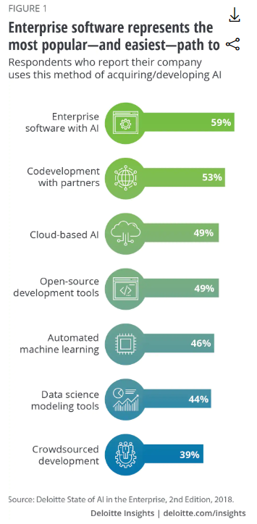
Where and how is it being used now?
30% of large companies in the U.S. have undertaken AI projects
More than 2000 AI startups
At least 6 AI research think tanks (Stanford, Toronto, MIT, MIRI, DARPA, OpenAI)
55 companies report AI as a risk in 2018 annual reports

Slide 3
“Issues in the use of artificial intelligence in our offerings may result in reputational harm or liability. We are building AI into many of our offerings and we expect this element of our business to grow. We envision a future in which AI operating in our devices, applications, and the cloud helps our customers be more productive in their work and personal lives. As with many disruptive innovations, AI presents risks and challenges that could affect its adoption, and therefore our business. AI algorithms may be flawed. Datasets may be insufficient or contain biased information. Inappropriate or controversial data practices by Microsoft or others could impair the acceptance of AI solutions. These deficiencies could undermine the decisions, predictions, or analysis AI applications produce, subjecting us to competitive harm, legal liability, and brand or reputational harm. Some AI scenarios present ethical issues. If we enable or offer AI solutions that are controversial because of their impact on human rights, privacy, employment, or other social issues, we may experience brand or reputational harm.” (Microsoft 2018 p 28)

Slide 4
Audit context: “Trust but verify”
“With all these exciting innovations, it is important to remind ourselves that the advent of emerging technologies does not change the fundamental financial reporting framework. If an emerging technology is being used to meet financial reporting of internal control requirements established by the federal securities laws, then auditors need to understand the design and implementation of that technology.” – PCAOB Board Member, Kathleen Hamm
Remarks made during a key presentation at the 43rd World Continuous Auditing & Reporting Symposium, November 2018, Newark, NJ., USA.

Slide 5
Artificial Intelligence & Machine learning
The very deep dark black box

Slide 7
What is ai? Machine learning? Deep learning?
Artificial Intelligence
Any technique that enables computers to mimic humans
If-Then rules, decision trees, expert systems
Machine Learning
Subset of AI that includes statistical techniques that enable computers to improve with experience
Deep Learning
Subset of machine learning that allows software to TRAIN ITSELF to perform tasks like speech and image recognition, by exposing multilayered neural networks to vast amounts of BIG DATA
ANN, deep learning
SVM, brute force algorithms

Slide 8
And speaking of human intelligence…..
Intelligence is complicated. It can have many faces like creativity, solving problems, pattern recognition, classiﬁcation, learning, induction, deduction, building analogies, optimization, surviving in an environment, language processing, intuition, knowledge and much more. Most, if not all, known aspects of intelligence can be viewed as goal-driven or, more precisely, as maximizing some utility function. AI is, therefore, goal-driven AI.

Slide 9
Where are we today?

Slide 10
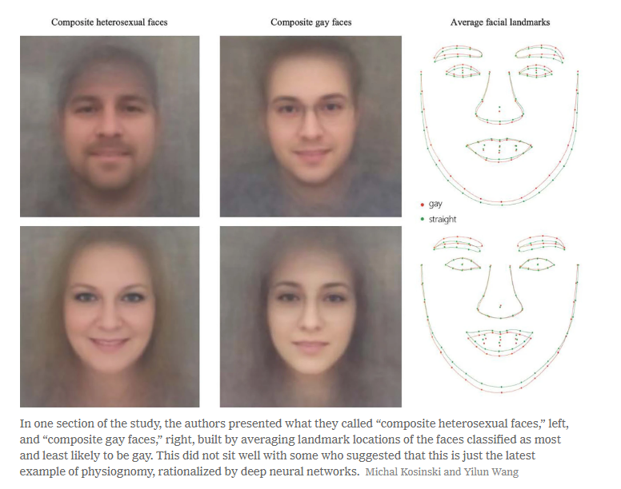
Stanford university AI facial recognition study

Slide 11
Explainable AI from David Gunning/DARPA (Defense Advanced Research Projects Agency 2017)

Slide 14
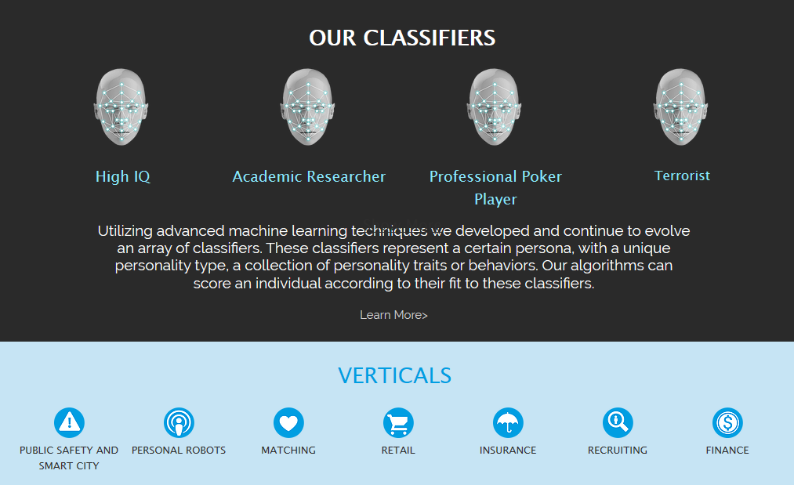
Why this is important: https://www.faception.com/

Slide 15
A reasonably assured audit of AI from an ethical perspective – 10,000 ft view
2-Risk Assessment
3-Identify Controls
4-Test Controls
5-Detailed Examination
6- Reasonably Assured Ethical AI System
1-Identify AI Application
This process holds for all types of AI – even Black Box AI!
A Black Box AI must be evaluated!

Slide 16
Phase One – AI Identification and its Ethical Implications
Identify the AI algorithms
Identify the objective(s)
Understand the context
Who
What
Where
When
Why?

Slide 17
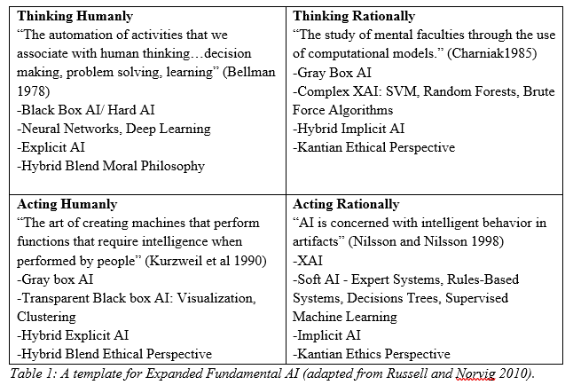

Slide 18
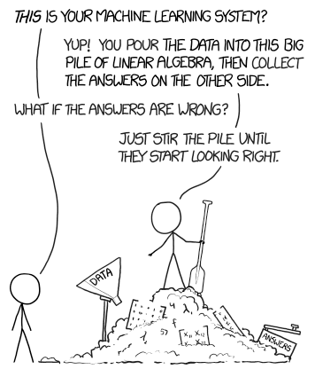
Phase Two - Ethical AI Risk Assessment Process
Ethical Risk* - magnifies the other risks
Information Risk
Reputation Risk
Financial Risk
Decision Risk
Execution Risk
Regulatory risk
Legal Risk
Complexity Risk* - new risk

Slide 19
Components of AI Risk and controls assessments
DATA
DESIGN
RESULTS
PEOPLE

Slide 20
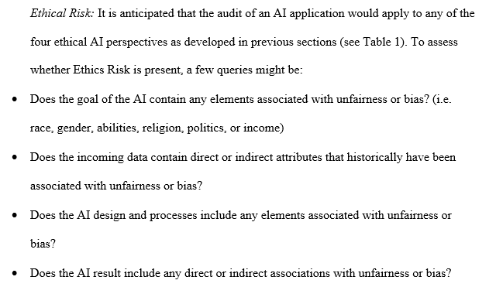

Slide 21
Phase Three - Ethical AI Internal Controls Guideline
The purpose of an ethical AI inherent controls guideline is to identify:
Inherent ethical risks from utilizing AI in business
Threats to organizations arising from unethical AI
Ethical vulnerabilities (internal and external to organizations)
The harm or adverse consequence to the firm from unethical AI
The likelihood that harm will occur from unethical AI
Identify the internal controls that have been designed and that are being enforced to mitigate these issues

Slide 22
Phase Three - Ethical AI Internal Controls Guideline
Asset Or Process | Inherent Ethical Risks: | Ethical Threats and Vulnerabilities | Likelihood and Impact | Ethics Internal Controls (Phase 4)
Data | 1-unexplainable 2-not understandable 3-Error 4-Bias 5-Data Prep issues 6-Privacy Concerns (GDPR) 7-external data 8-hacking 9-Access Controls | 1,2-complex, messy data 3-errors in data not identified 4-bias in data not identified 5-inadequate data pre-processing 6-data violates GDPR mandates 7-lack of data provenance 8-data was hacked before access 8-upload data streams hacked 9-Access controls not enforced | 1,2 -moderate to high likelihood & high impact 3-moderate likelihood & high impact 4-moderate likelihood & high impact 5-low to moderate likelihood & high impact 6-moderate to high likelihood & high impact 7-high likelihood & moderate impact 8-moderate likelihood & moderate impact 9-moderate likelihood & moderate to high impact | (these are the points of examination in Phase 4) 1-data has been examined with descriptive statistics and scrubbed/wrangled 2-descriptive statistics and exploratory analytics 3-data has been corrected/cleaned 3-anomaly detection 4-data has been examined with descriptive statistics and normalized/modified if there are ethical issues of bias/injustice 5-data is flagged for data prep and unsolvable ethics issues and pulled from the AI process 6-data is examined for GDPR issues and modified if needed for compliance 7- data provenance and integrity verified 8- data provenance and integrity verified 9-Access controls defined, enforced, and updated in all data processing systems

Slide 23
Phase Three - Ethical AI Internal Controls Guideline
AI Design (Ethical AI type specific) | 1-not explainable 2-not understandable 3-biased design 4-error in design 5-not correctable 6-rely on 3rd party algorithms 7-hacking 8-access controls | 1,2-too complex to explain 1,2-design execution is opaque 3-design enforces bias 3-design creates bias 4-design magnifies errors 4-design creates errors 5-design is uncorrectable 5-do not know where corrections should be made 6) lack of design provenance 7) lack of security 8) lack of access controls enforcement | These ratings are AI type specific | (These are the points of examination in Phase 4) 1,2,3,4,5-IT staff receives updated training with emphasis on bias/injustice 1,2,3,4,5-continual efforts are made to convert the AI to ethical XAI 1,2,3,4,5-reperform the AI process 6,7-audit the open source/3rd party platforms (SOC2 type report) 7-business-wide internet security training 8-access permissions embedded in AI platform 8-access permissions enforced 100% of the time

Slide 24
Phase Three - Ethical AI Internal Controls Guideline
AI Results (Ethical AI type specific) | 1-not explainable 2-not understandable 3-biases 4-errors 5-not correctable 6-hacking 7-access issues | 1,2-results are unexpected 1,2-unjustified results 3-results enforce biases 4-results enforce errors 5-results are not easily corrected 6-results data sets not stored securely 7-lsck of access controls enforcement | These ratings are AI type specific | (These are the points of examination in Phase 4) 1,2,3,4,5-results evaluated for ethical issues of accuracy, error, bias, unfairness 6-input and output control totals captured and measured 7-access permissions enforced for all circumstances

Slide 25
Phase Three - Ethical AI Internal Controls Guideline
Persons (executive, management, designers, auditor) | 1-poor AI familiarity 2- lack of firm strategy 3-poorly defined firm ethics 4-lack of oversight 5- 3rd party algorithms 6-IT development practices 7-access management issues 8-shared roles and responsibilities | 1-poor understanding of AI 2-poor understanding of firm strategy 1,2,3-not sure if AI aligns with firm strategy/ethics 3-unfamiliarity with firm ethics 4-lack of governance and oversight over AI development 5-over reliance on 3rd party developed AI algorithms 6-no established guidelines for IT development and integration 7-access controls not established nor enforced 8-sparce staff | 1-Moderate to high likelihood & moderate to high impact 2-low to moderate likelihood & high impact 3-moderate to high likelihood & high impact 4-moderate likelihood & high impact 5-moderate to high likelihood & high impact 6-low to moderate likelihood & moderate to high impact 7-moderate likelihood & high impact 8-low to moderate likelihood & high impact | 1-IT staff expertise 2-frequent review of firm strategy from an ethics perspective 3-frequent review of firm ethics 4-review of regulatory examinations in ethically sensitive topics 5-review of 3rd party AI for bias and injustice 6-Developed and adhered to AI procedure 7-access controls have been defined and are consistently enforced 8- Clearly defined rules and responsibilities that are consistently enforced

Slide 26
A reasonably assured audit of AI from an ethical perspective – where are we now?
2-Risk Assessment
3-Identify Controls
4-Test Controls
5-Detailed Examination
6- Reasonably Assured Ethical AI System
1-Identify AI Application
This process holds for all types of AI – even Black Box AI!
A Black Box AI must be evaluated!

Slide 27
Proposed framework for a reasonably assured ethical AI system

Slide 28
Future research questions

Slide 29
Contact details
THANK YOU!
appelbaumd@montclair.edu

